Slide 1
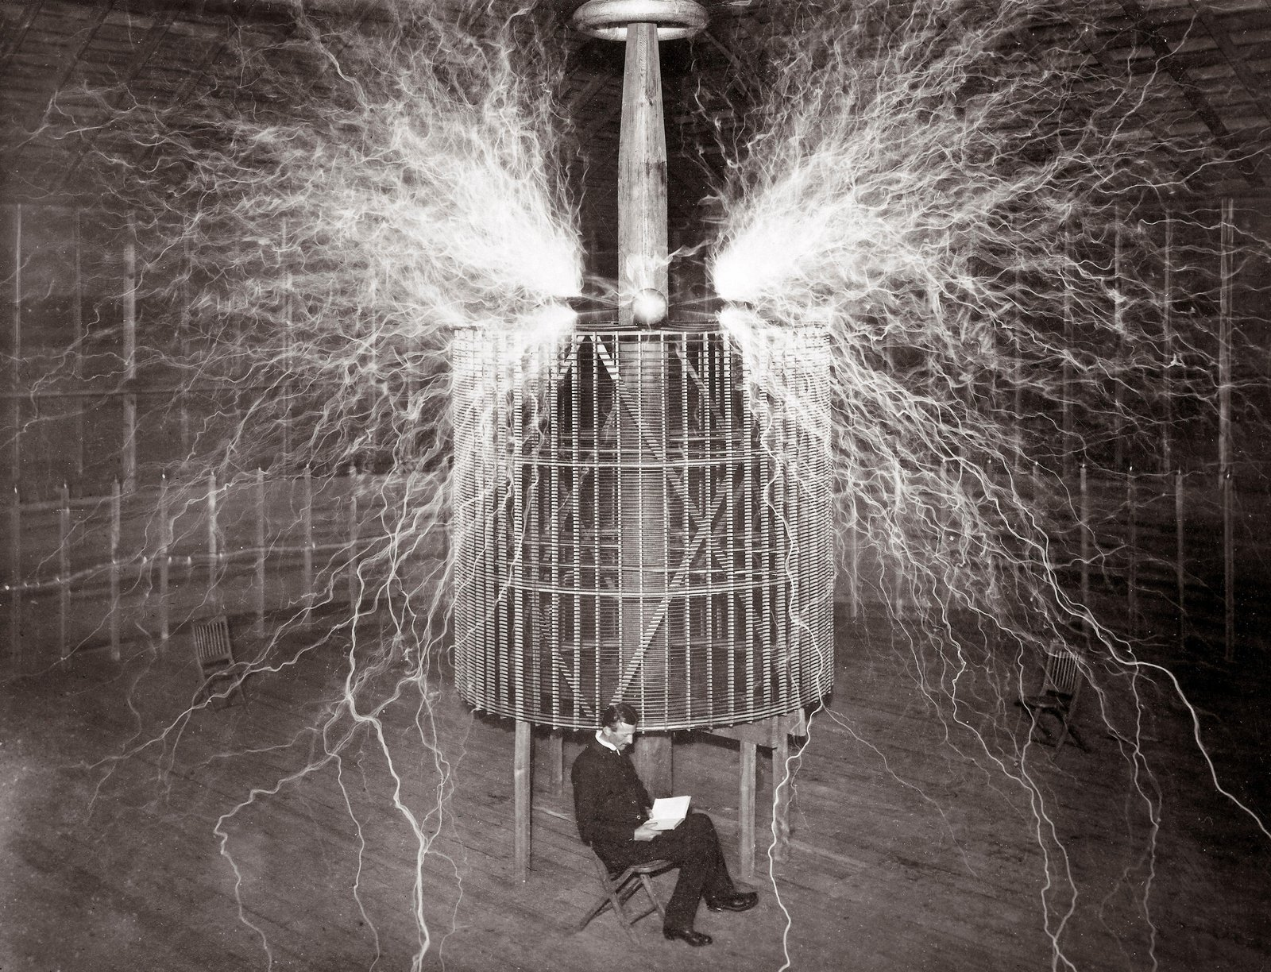
Build a Tesla Coil (the way Tesla built them)
(Hakasays, 2022)

Slide 2
What is a Tesla Coil?

Slide 4
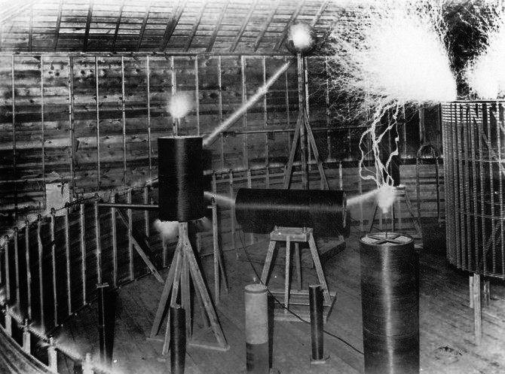

Slide 5
Tesla Coil vs. ‘Tesla Coil’

Slide 6
Tesla vs Oudin
Modern ‘Tesla’ coil
Oudin oscillator,
or ‘Oudin coil’,
Paul Marie Oudin
(circa 1890’s)

Slide 7
Tesla’s Coil,
Colorado Springs,
~1899
Eric Dollard’s
Tesla Coil,
Energy Science Technology Conference,
2019

Slide 8
Properties compared
Resonant induction coil (‘modern’ Tesla Coil) | Tesla Extra Coil
‘Tall’, height/width ratio of 3:1 or more | ‘Balanced’, height/width around 1:1
Many hundreds of turns (~500-1500) | Dozens of turns (~40-150)
High resistance coil | Low resistance coil
High inductance, minimal capacitance | Balanced inductance and capacitance
Low Q factor (usually less than 50) | High Q factor (50-200+)
Wide-band | Narrow-band
Stable, predictable frequency | Frequency changes wildly based on nearby conditions

Slide 10
Making an Extra coil (Tesla coil) Getting Started
Target frequency / wire length
Material selection
Construction
Testing/Tuning/Experimenting

Slide 11
Calculating Wire Length (for an unloaded coil)
Hakasays.com/DollardTeslaCoilCalculator
or
297/F = L
F = Frequency in Mhz
L = Wire length in Feet
(for a roughly 1-1 H/W coil with minimal frame load and good spacing between turns)

Slide 12
Framing Materials Selection
Framing material:
Best: UHMW, HDPE, LDPE, PTFE(Teflon), PP
OK: Polystyrene
Meh: Polycarbonate, Acrylic, Epoxies, PVC, Wood
* 3/16in to 1/4in works good for 4in to 16in coils
* Plastic sheet often comes in 12x12in or 24x24in
* White/light/clear plastics will have lower losses

Slide 13
Framing Material
General rule: lower dielectric constant = lower dissipative losses
Material | Dissipation Factor @1000kcps (lower=better)
HDPE / LDPE / UHMW | 0.0001
PTFE (Teflon) | 0.0003
PP (PolyPropylene) | 0.0004
Polycarbonate | 0.01
PMMA (Acrylic) | 0.014
Epoxy resins | ~0.01 to 0.05 (varies)
Wood | ~0.05 to 0.2 (varies by material and dryness)
PVC | ~0.1
PA (Nylon) | ~0.2

Slide 14
Wire selection
Goal: Lowest resistance practical
Copper: AWG20 or thicker
Silver-coated Teflon wire (loss tangent 0.0003)
Silicone-coated wire (loss tangent ~0.001)
Litz wire
RG6/Coax cable inner/outer conductor

Slide 15
Construction (‘Jigsaw’ method)

Slide 16
Construction Tools
Minimum
Drill + drillbit set
Jigsaw / router / hand saw
Hand files or chisel
Nice to have but not necessary:
Table saw / circular saw / bandsaw
CNC mill / CNC router

Slide 17
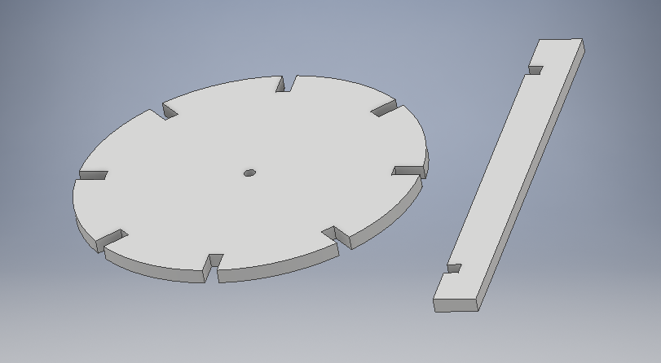
Construction Layout (‘Jigsaw’ method)
2ea disks
vertical risers
(Usually 6 or 8)

Slide 18
Construction 1 / 6 (‘Jigsaw’ method)
Cutting the top+bottom disks

Slide 19
Construction 2 / 6 (‘Jigsaw’ method)
Notching the top+bottom disks
(notch width = material thickness)

Slide 20
Construction 3 / 6 (‘Jigsaw’ method)
Cutting+notching the vertical risers
and wire grooves

Slide 21
Construction 4 / 6 (‘Jigsaw’ method)

Slide 22
Construction 5 / 6 (‘Jigsaw’ method)

Slide 23
Construction 6 / 6 (‘Jigsaw’ method)

Slide 25
Testing/Tuning

Slide 26
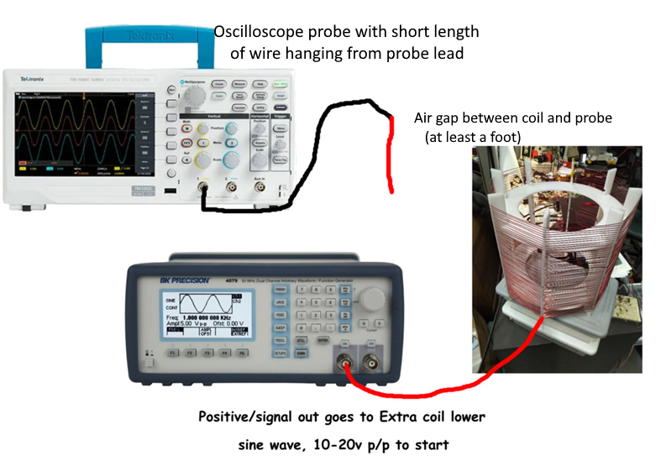
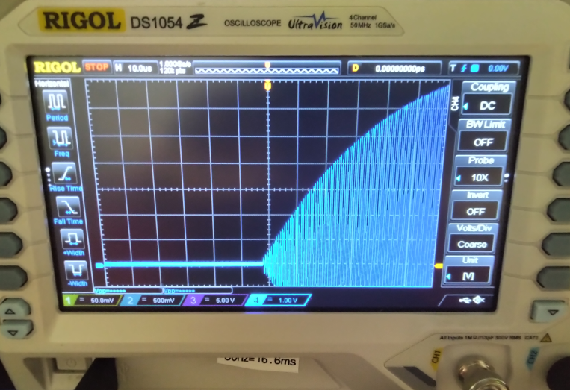
Testing/Tuning
Function generator + oscilloscope
Function generator + analog meter
Function generator + LED/Neon

Slide 27
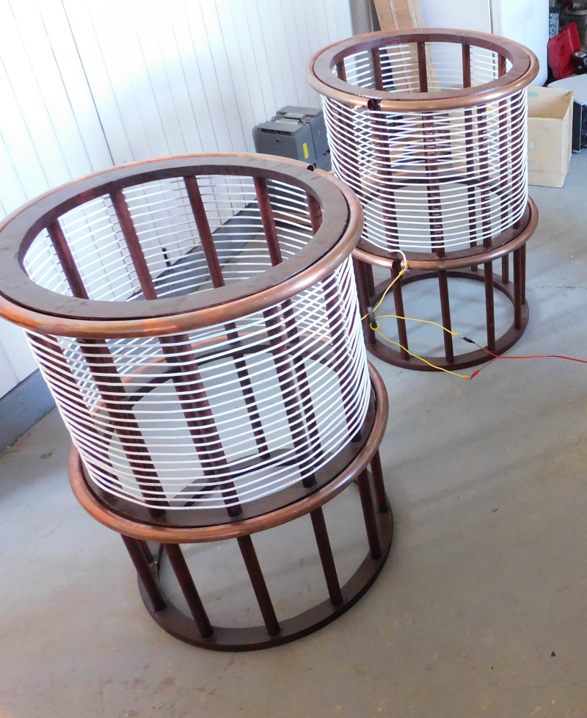
Topload (ring/sphere/toroid) (capacitive loading to decrease the resonant frequency and ‘stabilize’ the fields)

Slide 28
Possible Tesla Coil Experiments
Single wire lighting
Wireless lighting
Study/map monopolar field properties
Low-band HAM Radio antenna
Telluric (ground) signal+power transmission
Velocity / time-of-flight experiments
Parametric variation experiments
Cosmic Induction Generator experiments
Make cool sparks

Slide 29
Commercial/practical applications
Dead-simple one-coil high-voltage power supply
Homemade Theramin
Antenna-less HAM radio
Telluric (through-the-ground) communications and/or power transmission
PI/2*C communications transceiver

Slide 30
Moar power!
Two basic types: Driven vs. free-oscillating
HF radio transceivers (MARS mod)
HF linear amplifiers (vacuum tube and SS)
ZVS drivers / SSTC drivers
Armstrong oscillators
Neon-sign transformer setup

Slide 31
Go forth and build
- Build a Tesla Coil, 2022
- Web: Hakasays.com/blog
- minds.com/hakasays
- admin@hakasays.com
- bakahsay@gmail.com

Slide 32
